Slide 1
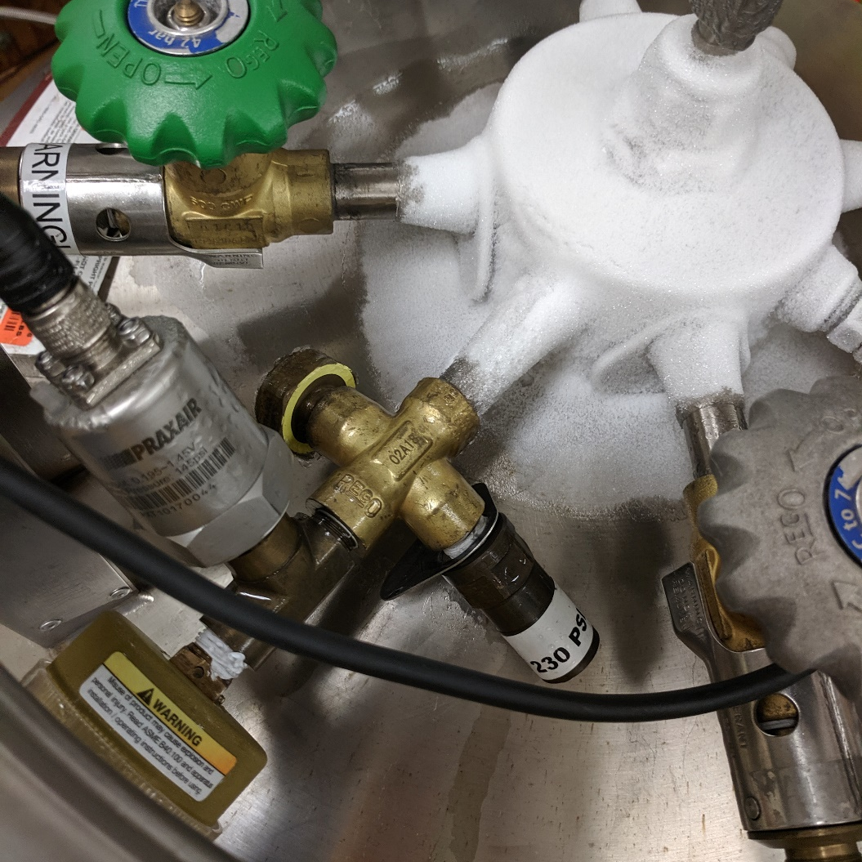
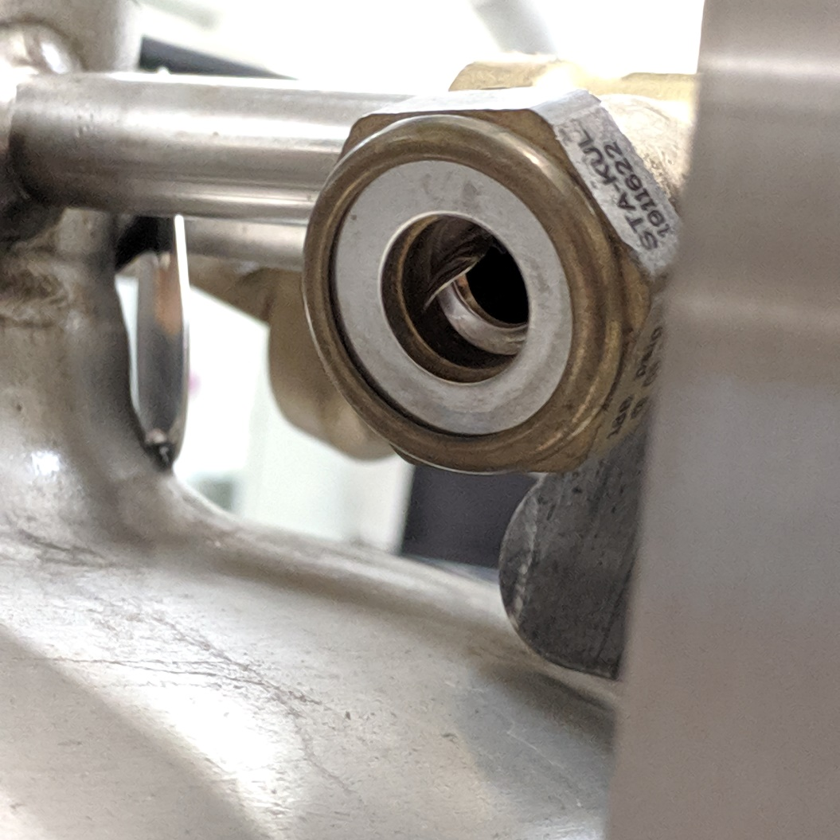
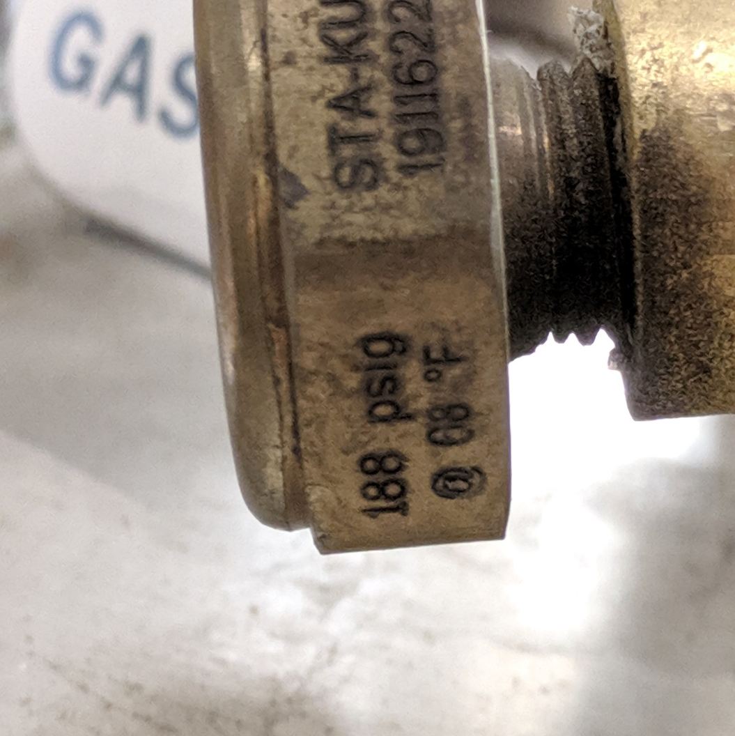
LAB INCIDENT SUMMARY: CRYOGEN RELEASE
Around 7:30 am, contractors were working in the building and heard a very loud noise in the room next door. It lasted for about 10 minutes, then tapered off. The contractors notified the building manager immediately. The building manager cleared the floor and notified EHS.
Incorrect inner vessel burst disc installed
  Tank was delivered one week prior and had appeared to be functioning normally (i.e., pressure relief valve was venting periodically)
  Supplier confirmed that the inner vessel burst disc (188 psig) was rated lower than the pressure relief valve (230 psig), resulting in burst disc rupture and product loss
EHS called the building manager to follow-up. The building manager suspected a gas cylinder release.
EHS responded and entered the lab, using respiratory protection and a gas monitor. EHS determined that oxygen levels were acceptable. No hazardous gases were detected.
EHS found that the inner vessel burst disc had ruptured on a tank of liquid argon. A 1L glass bottle of water had been knocked off a nearby cabinet, but remained intact.
There was no one working in the lab at the time of the incident. There were no other spills/releases. The lab was cleared for reentry.
Check the rating of burst discs on the tanks you receive
  Inner vessel burst disc should be rated for double the pressure relief valve (varies; pressure relief valve should be labeled)
Check position of burst disc when placing tank in a lab
  Point away from high traffic areas, chemical containers, and sensitive equipment
Ensure chemical inventories are entered in EHS Assistant for each lab room
  Without a current chemical inventory, it is difficult to assess hazards prior to entering
  Even if cryogen dissipated, still concerned about other chemicals that may have been damaged/leaking

