Slide 1
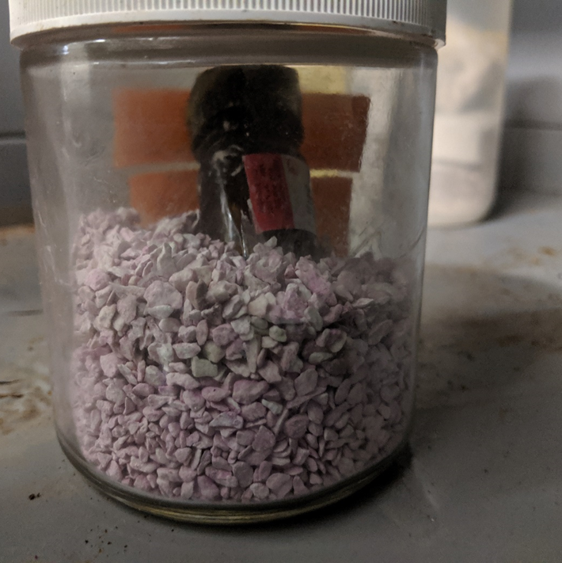
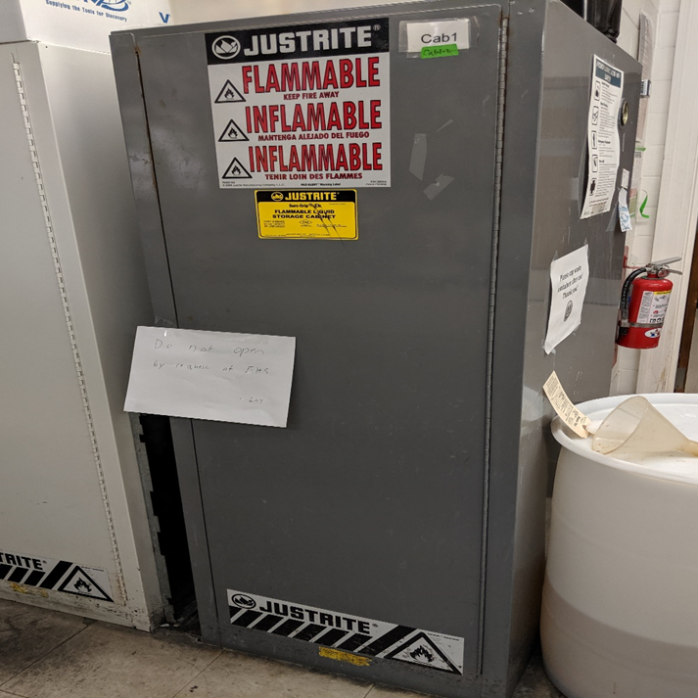
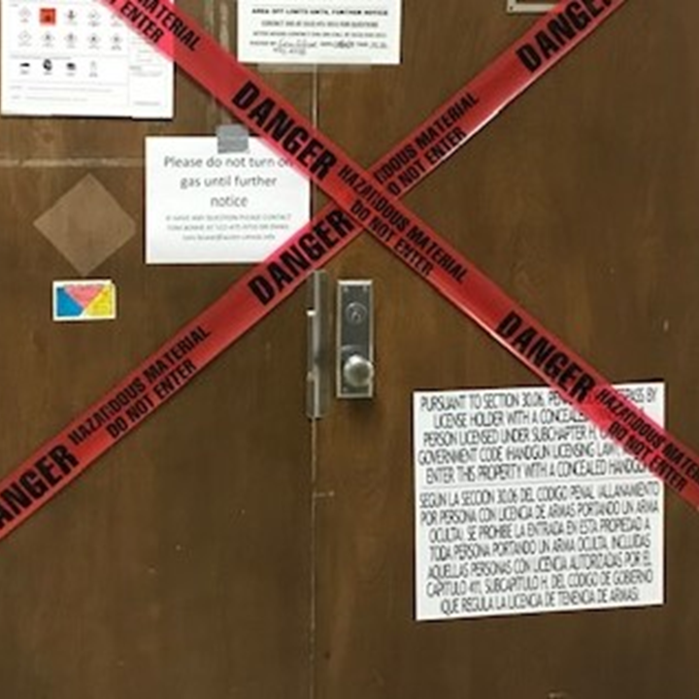
LAB INCIDENT SUMMARY: Dry Picric Acid
A graduate student discovered a bottle containing approximately 50gm of dried picric acid during a review of chemicals in a flammable materials storage cabinet. The crystals visible around the cap of the container can detonate when disturbed. The container of picric acid was stored inside another glass container with desiccant. The origin of the container or length of time the container existed in this condition was unknown to the lab.
Picric acid is stable while wet, but potentially explosive when dry.
The picric acid container was stored in a desiccant which accelerates drying.
Lab personnel were unaware of the presence of the container until they performed a review of the cabinet contents.
The container was not dated and was not routinely checked for evidence of drying/crystals.
Graduate student emailed EHS about the issue.
EHS immediately consulted a specialist to assess and remove the container.
Due to the potential explosive nature of dried picric acid, lab chemical inventory, and total volume of chemicals present, the lab was shut down for 2.5 days until the container could be safely removed.
UTPD and EHS accompanied the specialist during container removal as occupancy of immediate area was restricted.
Estimated special handling, mobilization and disposal cost to campus: $6,000.
Keep picric acid wet, a minimum 10% water by volume.
Establish protocol to train staff on chemical hazards, to regularly inspect and evaluate the integrity and condition of picric acid containers.
Where possible, purchase picric acid in solution. If you must purchase it as a hydrated/moistened solid, purchase the minimum amount possible and establish safe handling procedures to ensure that it does not dry out and that crystals do not form.
Date chemical containers with the date opened and dispose of any picric acid that is more than two years old.
Call EHS immediately when incidents occur or in an emergency.

